Slide 1
Event Handling

Slide 2
Event Issues
Event Dispatch
Bottom-up
Top-Down
Windowing system must handle events for any application
Windowing system may or may not assume compiler cooperation
Design-time vs. Runtime

Slide 3
Event Handling Properties
Ease of programming
Efficiency of event handling
Code reliability
Support for IDE (Interactive Design Environment)
Scalable to large user interfaces

Slide 4
Event Things to Know
For each approach
How it Works
Advantages
Disadvantages

Slide 5
Event Tables
0 MouseUp()
1 MouseDown()
2 MouseMove()
……
0 MouseUp()
1 MouseDown()
2 MouseMove()
……
0 MouseUp()
1 MouseDown()
2 MouseMove()
……
Advantages
Simple to implement
Each window is its own system
Disadvantages
Debugging mistakes
No IDE help

Slide 6
WindowProc
void rootWindowProc(Event, WindowData)
{ switch(Event.type)
{ . . . . .
}
}
void aWindowProc(Event, WindowData)
{ switch(Event.type)
{ . . . . .
}
}
void someWProc(Event, WindowData)
{ switch(Event.type)
{ . . . . .
default: superWProc( . . . )
}
}
Advantages
Simple
Window modular
Primitive inheritance
Disadvantages
No IDE help
Debugging issues again

Slide 7
Class Inheritance
public class Widget
{ public void mouseDown(int x, int y, int button)
{ default behavior }
public void mouseUp(int x, int y, int button)
{ default behavior }
public void keyInput(char key)
{ default behavior }
. . . . . .
}
public class PigTickler extends Widget
{ public void mouseDown(int x, int y, int button)
{ poke the pig }
public void mouseUp(int x, int y, int button)
{ wiggle your finger }
public void keyInput(char key)
{ rename the pig}
. . . . . .
}

Slide 8
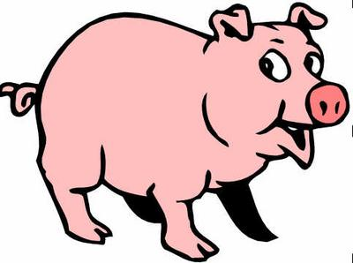
Window -> Object : Widget
Pigs: DualPane
Pane1 : PigTickler
Scroll1 : ScrollBar
Pane2 : PigTickler
Scroll2 : ScrollBar
MouseDown -> selectedWindow.myObject.MouseDown( new MouseEvent(…..) )

Slide 9
Class Inheritance
Virtual Table
public class Widget
{ public void mouseDown(int x, int y, int button)
{ default behavior }
public void mouseUp(int x, int y, int button)
{ default behavior }
public void keyInput(char key)
{ default behavior }
. . . . . .
}
0: mouseDown
1: mouseUp
2: keyInput
3:
. . . .
public class PigTickler extends Widget
{ public void mouseDown(int x, int y, int button)
{ poke the pig }
public void mouseUp(int x, int y, int button)
{ wiggle your finger }
public void keyInput(char key)
{ rename the pig}
. . . . . .
}
0: mouseDown
1: mouseUp
2: keyInput
3:
. . . .

Slide 10
Window -> Object : Widget
Pigs: DualPane
0:
1:
Pane1 : PigTickler
Scroll1 : ScrollBar
0:
1:
0:
1:
Pane2 : PigTickler
Scroll2 : ScrollBar
MouseDown -> selectedWindow.myObject.MouseDown( new MouseEvent(…..) )

Slide 11
Class Inheritance
public class Widget
{ public void mouseDown(int x, int y, int button)
{ default behavior }
public void mouseUp(int x, int y, int button)
{ default behavior }
public void keyInput(char key)
{ default behavior }
. . . . . .
}
Advantages
Language assistance
Debugging
Modular
Disadvantages
Virtual table size
Inheritance restrictions (see scroll bar handling)

Slide 12
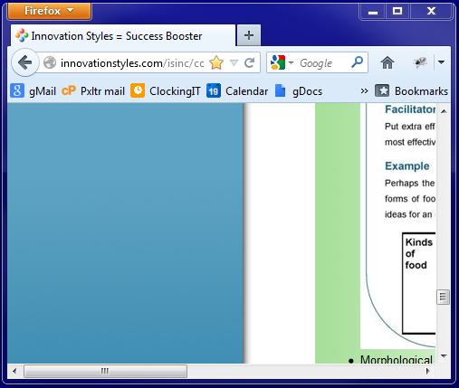

Slide 13
Listeners
class DoCoolStuff
{ private Vector<CoolListener> listeners;
public void addCoolListener(CoolListener c)
{ listeners.add(c); }
public void remCoolListener(CoolListener c)
{ listeners.remove(c); }
protected void coolHappened(CoolEvent e)
{ for (CoolListener c: listeners)
{ c.coolHappened(e); }
}
}
class CoolEvent
{ information about the event }
interface CoolListener
{ void coolHappened(CoolEvent e); }
Advantages
Modularity of event types
Separation from inheritance
Reflection in the IDE
Disadvantages
All events of a particular type go the same place

Slide 14
class ScrollBar extends Widget
{ private Vector<ScrollListener> listeners;
public void addScrollListener(ScrollListener c)
{ listeners.add(c); }
public void remScrollListener(ScrollListener c)
{ listeners.remove(c); }
protected void scrollHappened(ScrollEvent e)
{ for (ScrollListener c: listeners)
{ c.scrollHappened(e); }
}
}

Slide 15
class ScrollBar extends Widget
{ private Vector<ScrollListener> listeners;
public void addScrollListener(ScrollListener c)
{ listeners.add(c); }
public void remScrollListener(ScrollListener c)
{ listeners.remove(c); }
protected void scrollHappened(ScrollEvent e)
{ for (ScrollListener c: listeners)
{ c.scrollHappened(e); }
}
}
class Browser extends Widget
implements ScrollListener
{ public void scrollHappened(ScrollEvent e)
{ if (e.isVertical() )
scroll vertical;
else
scroll horizontal;
}
}

Slide 16
class ScrollBar extends Widget
{ private Vector<ScrollListener> listeners;
public void addScrollListener(ScrollListener c)
{ listeners.add(c); }
public void remScrollListener(ScrollListener c)
{ listeners.remove(c); }
protected void scrollHappened(ScrollEvent e)
{ for (ScrollListener c: listeners)
{ c.scrollHappened(e); }
}
}
class Browser extends Widget
implements ScrollListener
{ public void scrollHappened(ScrollEvent e)
{ if (e.isVertical() )
scroll vertical;
else
scroll horizontal;
}
}
class Firefox
{ public void main(String args[])
{ hScroll=new ScrollBar();
vScroll=new ScrollBar();
browse = new Browser();
hScroll.addScrollListener(browse);
vScroll.addScrollListener(browse);
}
}

Slide 17
Listeners
class DoCoolStuff
{ private Vector<CoolListener> listeners;
public void addCoolListener(CoolListener c)
{ listeners.add(c); }
public void remCoolListener(CoolListener c)
{ listeners.remove(c); }
protected void coolHappened(CoolEvent e)
{ for (CoolListener c: listeners)
{ c.coolHappened(e); }
}
}
class CoolEvent
{ information about the event }
interface CoolListener
{ void coolHappened(CoolEvent e); }
Advantages
Modularity of event types
Separation from inheritance
Reflection in the IDE
Disadvantages
All events of a particular type go the same place

Slide 18
class ScrollBar extends Widget
{ private Vector<ScrollListener> listeners;
public void addScrollListener(ScrollListener c)
{ listeners.add(c); }
public void remScrollListener(ScrollListener c)
{ listeners.remove(c); }
protected void scrollHappened(ScrollEvent e)
{ for (ScrollListener c: listeners)
{ c.scrollHappened(e); }
}
}
class Browser extends Widget
implements ScrollListener
{ public void scrollHappened(ScrollEvent e)
{ if ( e.isVertical() )
scroll vertical;
else
scroll horizontal;
}
}
class Firefox
{ public void main(String args[])
{ hScroll=new ScrollBar();
vScroll=new ScrollBar();
browse = new Browser();
hScroll.addScrollListener(browse);
vScroll.addScrollListener(browse);
}
}

Slide 19
Delegates
public delegate void coolEventHandler(CoolEvent e)
public class DoCoolStuff
{
public coolEventHandler handler;
public void processMouseEvent(Event e)
{ handler(new CoolEvent() );
. . . . . .
}
}
public class BunchOfCoolness
{ public BunchOfCoolness()
{ DoCoolStuff cool1;
cool1.handler = catch1;
DoCoolStuff cool2;
coo12.handler=catch2;
}
private void catch2(CoolEvent e)
{ . . . . . . }
private void catch1(CoolEvent e)
{ . . . . . . . }
}

Slide 20
public delegate ScrollHandler(ScrollEvent);
class ScrollBar extends Widget
{ public ScrollHandler scrollEvent;
}

Slide 21
public delegate ScrollHandler(ScrollEvent);
class ScrollBar extends Widget
{ public ScrollHandler scrollEvent;
}
class Browser extends Widget
implements ScrollListener
{
public void scrollVertical(ScrollEvent e)
{ … }
public void scrollHorizontal(ScrollEvent e)
{ … }
}

Slide 22
public delegate ScrollHandler(ScrollEvent);
class ScrollBar extends Widget
{ public ScrollHandler scrollEvent;
}
class Firefox
{ public void main(String args[])
{ hScroll=new ScrollBar();
vScroll=new ScrollBar();
browse = new Browser();
hScroll.scrollEvent =
browse.scrollHorizontal;
vScroll.scrollEvent =
browse.scrollVertical;
}
}
class Browser extends Widget
implements ScrollListener
{
public void scrollVertical(ScrollEvent e)
{ … }
public void scrollHorizontal(ScrollEvent e)
{ … }
}

Slide 23
Delegates
public delegate void coolEventHandler(CoolEvent e)
public class DoCoolStuff
{
public coolEventHandler handler;
public void processMouseEvent(Event e)
{ handler(new CoolEvent() );
. . . . . .
}
}
public class BunchOfCoolness
{ public BunchOfCoolness()
{ DoCoolStuff cool1;
cool1.handler = catch1;
DoCoolStuff cool2;
coo12.handler=catch2;
}
private void catch2(CoolEvent e)
{ . . . . . . }
private void catch1(CoolEvent e)
{ . . . . . . . }
}
Advantages
Each event targeted
Some IDE help
Disadvantages
?

Slide 24
Interpretive Language
<div onclick=“myDivClicked(A+3)” > …</div>
eval(onclick)
Variable bindings

Slide 25
Anonymous Functions
<div onclick=function(X,Y){ return A+X; } > …</div>
Variables where function is created
onclick(X,Y) somewhere inside of <div>

Slide 26
Event Handling
Event Queue and switch on event type
Event Tables
Class Inheritance
Listeners
Delegates

